Slide 1
Crafting & Compelling Website Analysis, Audit and Recommendations for Apple
SHREYAS REDDY KANTHAREDDY

Slide 2
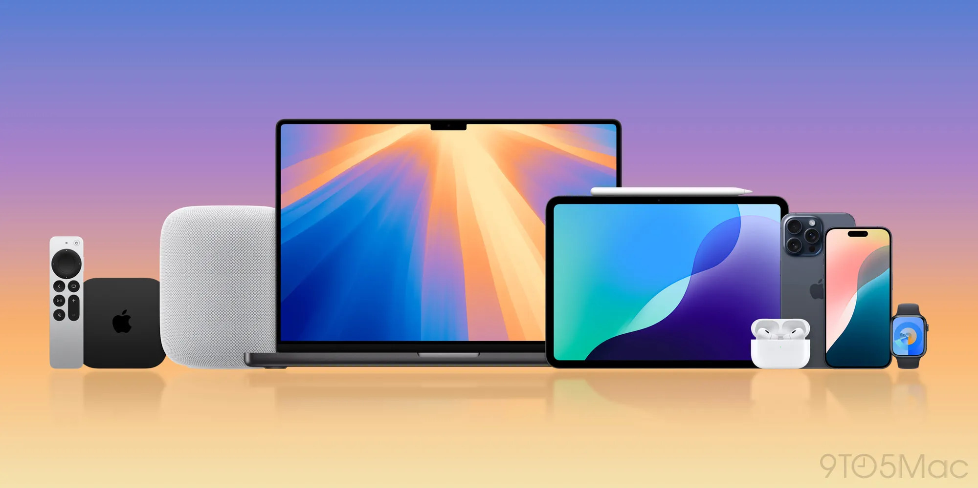
Task 1: Company selection for the web analysis
Apple Inc. is a global technology leader, best known for its innovative products like the iPhone, MacBook, iPhone and Apple Watch. Founded in 1976 by Steve Jobs, Steve Wozniak, and Ronald Wayne, Apple combines sleek design, cutting-edge technology, and a seamless ecosystem of devices and services to deliver exceptional user experiences. The company also leads in software innovation, offering operating systems like iOS and macOS, alongside services such as iCloud, Apple Music, and the App Store.

Slide 3
Task 2: Product and Service Descriptions
iPhone: Apple's flagship smartphone, combining advanced technology, high-resolution cameras, and the iOS ecosystem for a seamless user experience.
iPad: A versatile tablet designed for creativity, productivity, and entertainment, offering powerful performance and compatibility with the Apple Pencil.
MacBook: A line of premium laptops with Retina displays and M-series chips, designed for exceptional speed, battery life, and macOS integration.
AirPods: Wireless earbuds featuring immersive sound, noise cancellation, and effortless connectivity with Apple devices.
Apple Watch: A wearable device for health, fitness, and staying connected, offering features like heart rate monitoring and customizable bands.

Slide 4
Task 3: Website Platform Identification using Wappalyzer
Static Site Generators or Frameworks: Next.js(14.2.14)
Content Management System (CMS): Adobe Experience Manager
Programming Language: Java and GraphQL
Web server : Next.js (14.2.14)
Security : HSTS (HTTP Strict Transport Security)
Analytics : Adobe Analytics
Font scripts : Google Font API

Slide 5
Task 4: Responsive Design Testing using Gtmetrix
FCP(first contenful paint): 0.9 or less
Speed index : 1.3s or less
LCP(largest contentful paint): 1.2s or less
Time to interactive: 2.5s or less
Pages tested :
Home page: It is a mobile friendly page, but the speed index is a bit longer(1.8s) than recommended(1.3s). There were 18 render-blocking requests.
Mac page: The speed index is very poor with 7.0s this used to know how quickly the contents of your page are visibly populated. The first contentful paint appear at 1.8s.
iPhone page: The performance is very poor with 39%. The page takes 7.1s to become fully interactive where a good user experience is 2.5s or less.
iPad page: The overall performance is very bad with 36%. FCP is 2.1s, speed index is 8.9s, LCP is 3.1s, and time to interactive is 4.9s.
Apple watch: Gtmetrix grade is E and the perforce is 46%. It takes 4.1s to load the page fully.

Slide 6

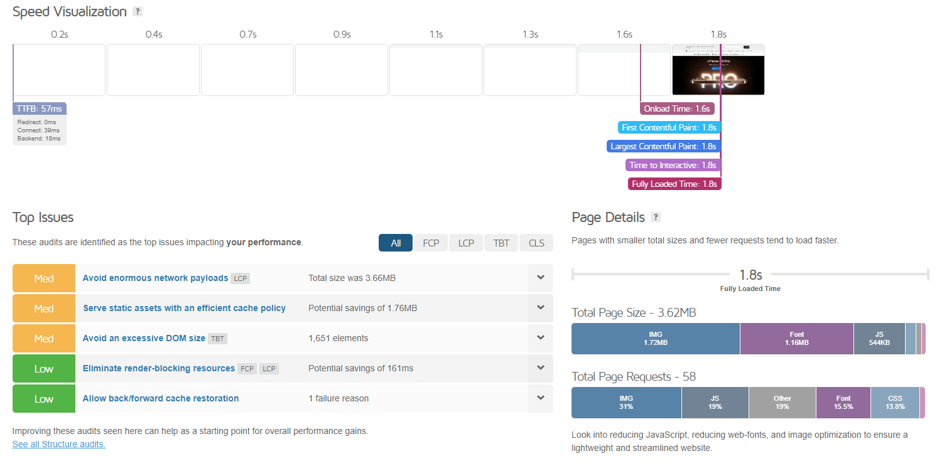
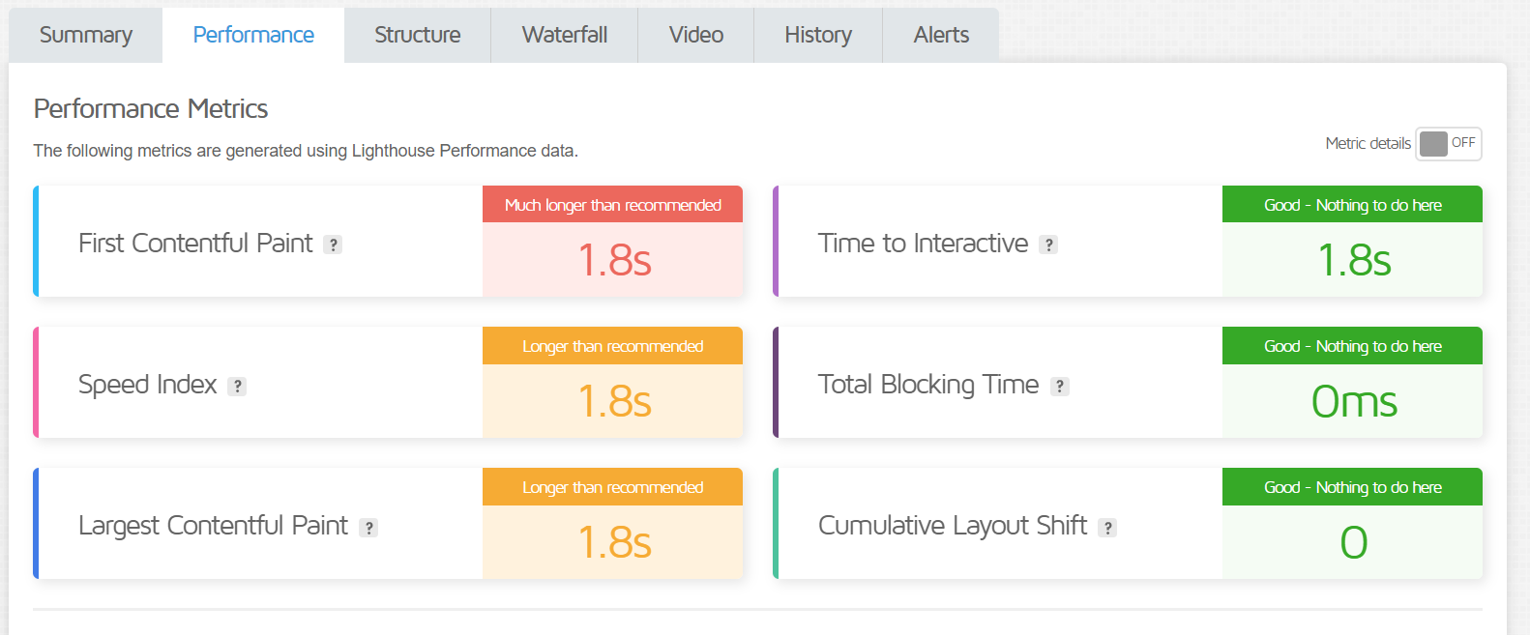
Task 4: Responsive Design Testing using Gtmetrix

Slide 7
Task 5: Website Mistakes Identification
Mistakes:
Slow loading time: Large network payloads (e.g., iPhone page: 9.39MB, Watch page: 4.50MB) mean the browser must download a lot of data, making the pages slower to load.
Using excessive DOM Size : The DOM (Document Object Model) contains all the elements of a webpage. Pages like the iPhone page, with over 4,000 elements, are too complex for browsers to process efficiently.
Increase in Render-Blocking Resources(includes JavaScript and CSS): It increases the time users wait for the page to become usable.
Lack of Image Optimization: Unoptimized images lead to slower page speeds and higher data usage.
Long main-thread tasks: Pages have long main-thread tasks (e.g., 1.2–1.5 seconds on iPhone and Watch pages), which delay rendering and interactivity.
Recommendations:
Reduce file sizes
Optimize videos by reducing resolution for smaller screens
Minimize Dynamic Content
Optimize the image quality
Avoid long main-thread tasks

Slide 8
Task 6: Best Practices List
Fast loading speed
Responsive design (mobile-friendly)
Better navigation (clear menu)
Engaging and relevant content
Better User Experience(UX) design
Prominent Call-to-Action buttons
Uniform branding across every page
Good usage of keywords
Collect feedback from visitors
High-Quality Engaging Visuals

Slide 9
Task 7: Landing Page Design
The landing page is been created using a design tool called WIX.
Landing page URL: https://reddyshreyas9.wixsite.com/my-site-8

Slide 10
THANK YOU

